Slide 1
Starship
RAD Networks communications
Students:
Aviel Avitan
Amir Loewenthal
RAD Mentor:
Raz Oz

Slide 2

Agenda
The Project
Software Architecture
Tools used
APIs
Live Demo

Slide 3
The Project

Slide 4
פרופיל התמחות
שם תפקיד להתמחות: מפתח תוכנה בתחום אבטחת המידע באפליקציית ניהול רשתות תקשורת
תיאור ההתמחות: כתיבת אפליקציה בשפת JAVA המגינה מפני גישה, שימוש, העתקה או השמדה של מידע מצד גורמים זדוניים או שאינם מורשים. לצורך כך נממש שרת באמצעות SPRING BOOT, אשר מתקשר עם שרת KEYCLOCK, הנותן יכולות אבטחה ותומך במנגנון 2.0-OAUTH שמבצע אימותים מול מערכות כמו GOOGLE ו-FACEBOOK. כמו כן נוכל להתממשק מול מערכות ענן כגון AWS. על האפליקציה לספק RESTFUL API בעל יכולות ניהול משתמשים, נתינת הרשאות, ואימות זהות המשתמשים. במהלך הפרוייקט המפתח ייחשף למגוון של פלטפורמות, שיטות עבודה ופרוטוקולים שונים.
מחלקה בארגון: מחלקת ניהול רשתות
פעילות המחלקה: המחלקה מפתחת אפליקציה ייעודית לניהול מוצרים ברשת תקשורת, כולל הקמה ותפעול של שירותים ברשת, בדיקתם, וניטורם לאורך זמן.
כתובת: חלקיקי האור 16, באר שבע
תחומי לימוד: הנדסת תוכנה
כישורים נוספים נדרשים: ידע בתכנות בשפת JAVA. יכולת לימוד עצמית. לא נדרש כל ידע או ניסיון בתחום התקשורת או אבטחת מידע.
ימים ושעות רצויים: גמיש

Slide 5
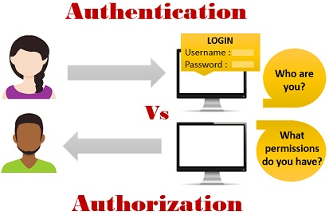
The Goal
Our project, a single-page application, will be a public-facing website. We want to restrict access to registered users only. Furthermore, we want to tailor each user’s experience, and the amount and type of data that they can view, to their individual roles and access levels.
In other words, we want to be able to authenticate and authorize each user. Authentication means verifying that someone is indeed who they claim to be. Authorization means deciding which resources a certain user should be able to access, and what they should be allowed to do with those resources. Oftentimes, as in our case, an application will require a little bit of both.

Slide 6
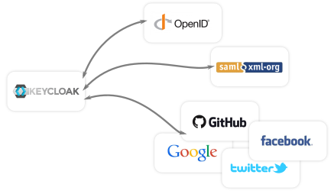
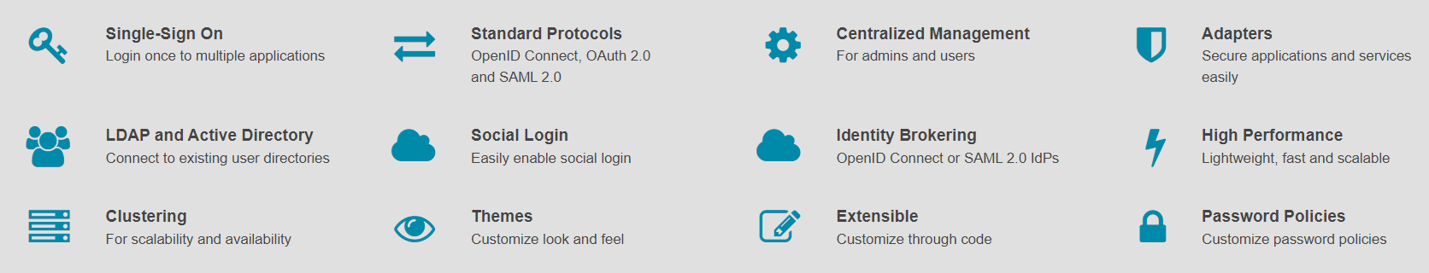
Keycloak server
Looking for an option to fit both our application and our customer’s security policies, we will use Keycloak server which supports OpenID, OAuth2, and SAML.

Slide 7
Server Architecture

Slide 8
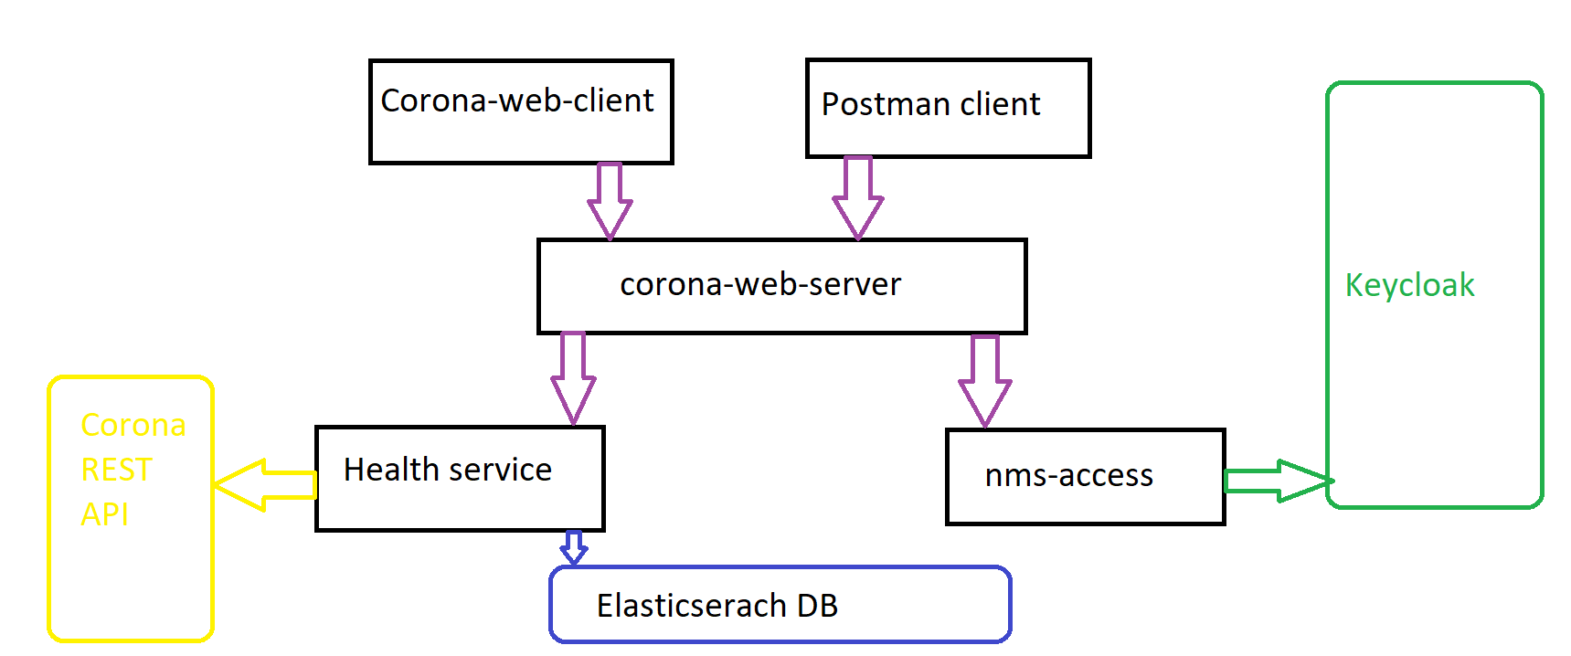
Server Architecture

Slide 9
Server Architecture
The application has several components:
corona-web-client: Web client built in angular
corona-web-server
health-data-service
nms-access-service

Slide 10
Corona-Web-Server
Java server build with Spring boot. Its purpose is to serve the web-client requests and send them to the appropriate service. Broker.

Slide 11
Health-Data-Service
Java server build with Spring boot. Its purpose is to get data about the Coronavirus from REST APIs in the internet.

Slide 12
NMS-Access-Service
Java server build with Spring boot. Its purpose is to be integrator with the Keycloak server. It should user the Keycloak service API to manage users, roles and tenants.

Slide 13
Tools Used

Slide 14

SPRING Framework
Spring makes programming Java quicker, easier, and safer for everybody. Spring’s focus on speed, simplicity, and productivity has made it the world's most popular Java framework.
We used Spring Web Server and Spring Security for the different Java web Servers

Slide 15

Kafka
Apache Kafka® is a distributed streaming platform.
Publish and subscribe to streams of records, similar to a message queue or enterprise messaging system.
We used kafka to stream events from keycloak server to ElasticSearch DB

Slide 16

ElasticSearch / Kibana
Elasticsearch is a NOSQL JSON-Based Database.
We Used ElasticSearch to Store Corona Virus data and data about events in the nms system.
Kibana is a free and open user interface that lets you visualize your Elasticsearch data. We used it to visualize the data about the events.

Slide 17
APIS

Slide 18
Management APIS
Login – API for login to the system by username and password, OTP is optional.
Logout - API for logout.
Get/Post settings – Set system setting regards keycloak configuration.
Get sessions – Get all current active sessions.
Get Events – Get all system Events (login, logout, etc.)

Slide 19
Users APIs
Get all users/ user by id – API for getting registered users.
Add user – API request to add a user to our application.
Delete user – API request to delete a user by user id.
Update user – API request to update a user’s details by user id.

Slide 20
Roles APIs
Get roles– API for getting all the roles that exists.
Add role – API request to add a role to our application.
Delete role – API request to delete a user by role id or by role name.
Update role – API request to update a role’s details by role id.
Get permissions – API request to get all of the existing permissions.

Slide 21
Tenants Apis
Get tenants– API for getting existing tenants.
Add tenant – API request to add a tenant to our application.
Delete tenant – API request to tenant a user by tenant id.
Update tenant – API request to update a tenant’s details by tenant id.

Slide 22
Corona APIS
Get corona data – API for getting the corona data that is compatible to the tenant you are logged in to.
Get total latest – API for getting all of the corona data on all of the countries since the start of the corona.
Get total daily – API for getting all of the corona data in a specific data.

Slide 23
External APIS
CORONA DATA API - We Used an external API from RAPID-API Website in order to get a relevant and updated covid-19 data.
Keycloak Admin Java API – We used an external keycloak API to modify keycloak users, roles, and tenants in java(add, delete, update, get).

Slide 24
Live Demo

Slide 25
Live Demo
-Create and edit new tenant:
demo-tenant, continent: America.
-Create new role:
demo-role, permission: user read/write, corona read.

Slide 26
Live Demo
-Create new user:
username: demo_user
role: demo_role
tenant: demo_tenant
-Get corona data on different users.
-Show system events, sessions,settings.

